Slide 1

UNIVERSITY INSTITUTE OF ENGINEERING
COMPUTER SCIENCE ENGINEERING
Master of Engineering
ADVANCED DATA STRUCTURES
&
ALGORITHMS
(23CSH-622)
INTRODUCTION
DISCOVER . LEARN . EMPOWER

Slide 2

ADVANCED DATA STRUCTURES
&
ALGORITHMS
(23CSH-622)
By : Dr. Ranjit Singh (E10947)
www. cuchd.in Campus : Gharaun, Mohali

Slide 3
INTRODUCTION
Course Outcome
Will be covered in this lecture
CO Number | Title | Level
CO1 | To understand role of algorithms in science and practice of computing.. | Remember
CO2 | To gain familiarization with different algorithm design techniques. | Understand
CO3 | To apply different algorithm design techniques for solving engineering and related problems and study their performance. | Analysis and application

Slide 4
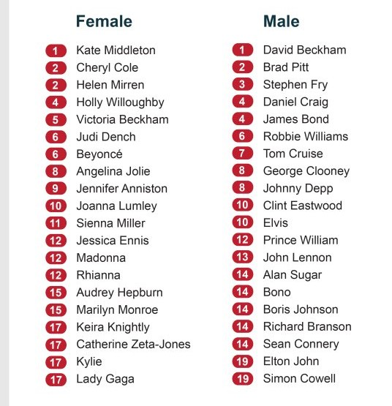
ACTIVITY

Slide 5
Course Objectives
To understand role of algorithms in science and practice of computing.
To gain familiarization with different algorithm design techniques.
To apply different algorithm design techniques for solving engineering and related problems and study their performance.

Slide 6
Course Outcomes
Various Basic and Advanced Data Structures and the related Algorithms
Algorithm Complexity and Analysis of various searching & sorting.
To apply Dynamic Programming Approach in problem solving.

Slide 7
Lecture Objectives
To understand the properties of various data structures.
To apply different data structures for modeling real world problems.

Slide 8
Lecture Outcomes
Student will learn the need for this subject
Will understand the various data structures and their real life applications.
Will Identify the strengths and weaknesses of different data structures
Will learn the various operations possible on any given Data Structure

Slide 9
Syllabus/Topics To be Covered
Concept of data and information
Introduction to Data Structures
Types of data structure: Linear and non-linear data structures
Operations on Data Structures

Slide 10
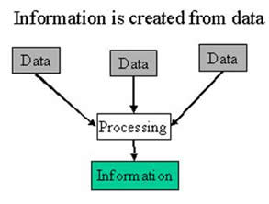
Data & Information
Data - Data usually refers to raw data, or unprocessed data. It is the basic form of data, data that hasn’t been analyzed or processed in any manner. Eg: 123, Ajay
Information - Once the data is analyzed, it is considered as information.
Eg: Roll no:123, Name=“Ajay”

Slide 11
Data Type and Data Structure
Data type
Set of possible values for variables
Operations on those values
Ex : int, float, char ……….
Data Structure
A data structure is an arrangement of data in a computer's memory or even disk storage.
The logical and mathematical model of a particular organization of data is called a data structure.
A data structure is a particular way of storing and organizing data in a computer so that it can be used efficiently.

Slide 12
Linear and Non-Linear Data structures
Linear data structure: A data structure is said to be linear if the elements form a sequence, for example Array, Linked list, stack ,queue etc.
Non-Linear data structure: Elements in a nonlinear data structure do not form a sequence, for example Tree, graph.

Slide 13
Operations on Data Structure
Traversing: Accessing each records exactly once so that certain items in the record may be processed.
Searching: Finding the location of a particular record with a given key value, or finding the location of all records which satisfy one or more conditions.
Inserting: Adding a new record to the structure.
Deleting: Removing the record from the structure.
Sorting: Managing the data or record in some logical order(Ascending or descending order).
Merging: Combining the record in two different sorted files into a single sorted file.

Slide 14
Arrays
Linear array (One dimensional array) : A list of finite number n of similar data elements referenced respectively by a set of n consecutive numbers, usually 1, 2, 3,…..n. That is a specific element is accessed by an index.
Let, Array name is A then the elements of A is : a₁,a₂….. A_{n} or by the bracket notation A[1], A[2], A[3],…………., A[n].The number k in A[k] is called a subscript and A[k] is called a subscripted variable.

Slide 15
Array (con…)
Array Data Structure
It can hold multiple values of a single type.
Elements are referenced by the array name and an ordinal index.
Each element is a value
Indexing begins at zero in C.
The array forms a contiguous list in memory.
The name of the array holds the address of the first array element.
We specify the array size at compile time, often with a named constant or at run time using calloc(), malloc() & realloc() in C and new in C++.
Arrays – Advantage & disadvantage
Fast element access.
Impossible to resize. Many applications require resizing so linked list was introduced.

Slide 16
Linear Arrays
A linear array is a list of finite number n of homogeneous data elements(i.e. data elements of same type)
The elements of the array are referenced respectively by an index set
The elements of the array are stored respectively in successive memory locations.
Let, Array name is A then the elements of A is : a1,a2….. an
Or by the bracket notation A[1], A[2], A[3],…………., A[n]
1 2 3 4 5 6 | 247
 | 56
 | 429
 | 135
 | 87
 | 156
DATA[1] = 247
DATA[2] = 56
DATA[3] = 429
DATA[4] = 135
DATA[5] = 87
DATA[6] = 156

Slide 17
Representation of linear array in memory
Let LA be a linear array in the memory of the computer. The memory of the computer is a sequence of addressed locations.
LA
1000 1001 1002 1003 1004 1005
The computer does not need to keep track of the address of every element of LA, but needs to keep track only of the first element of LA, denoted by
Base(LA)
called the base address of LA. Using this address Base(LA), the computer calculates the address of any element of LA by the following formula :
LOC(LA[k]) = Base(LA) + w(K – lower bound)
Where w is the number of words per memory cell for the array LA
Fig : Computer memory

Slide 18
Representation of linear array in memory
200 201 202 203 204 205 206 207 208 209 210 211 212
INDEX
Example :
An automobile company uses an array AUTO to record the number of auto mobile sold each year from 1932 through 1984. Suppose AUTO appears in memory as pictured in fig A . That is Base(AUTO) = 200, and w = 4 words per memory cell for AUTO. Then,
LOC(AUTO[1932]) = 200, LOC(AUTO[1933]) =204
LOC(AUTO[1934]) = 208
the address of the array element for the year K = 1965 can be obtained by using :
LOC(AUTO[1965]) = Base(AUTO) + w(1965 – lower bound)
=200+4(1965-1932)=332
AUTO[1932]
AUTO[1933]
AUTO[1934]

Slide 19
Link Lists
A list implemented by each item having a link to the next item.
Each node consists of its own data and the address of the next node and forms a chain.
Linked Lists are used to create trees and graphs.

Slide 20
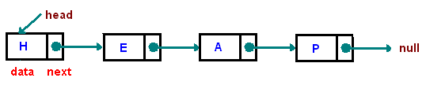
REPRESENTATIONS
[1]

Slide 21
APPLICATION OF LINK LIST
Forward and backward link of web page
Hash tables
Representing Graphs as Adjacency lists.

Slide 22
ARRAYS VS LINKLISTS
Arrays
• have a pre-determined fixed size
• easy access to any element a[i] in constant time
• no space overhead
• Size = n x sizeof(element)
Linked lists
• no fixed size, grow one element at a time.
• space overhead
• each element must store an additional reference
• Size = n x sizeof (element) + n x sizeof(reference)
• no easy access to i-th element wrt the head of the list • need to hop through all previous elements

Slide 23
DEFINITION OF STACK
A stack is a container of objects that are inserted and removed according to the last-in first-out (LIFO) principle.
two operations on stack are:
push the item into the stack
pop the item out of the stack.

Slide 24
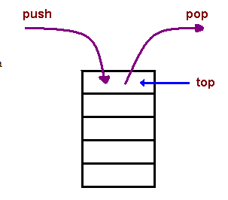
REPRESENTATIONS OF STACK
[1]

Slide 25
APPLICATION OF STACK
Expression evaluation
Expression conversion
Parsing
Simulation of recursion
Function calls

Slide 26
QUEUES
A Queue is a linear list of elements in which deletions can take place only at one end, called the front, and insertions can take place only at the other end, called the rear. The terms “front” and “rear” are used in describing a linear list only when it implemented as a queue.
Queues are also called first-in first-out (FIFO) lists, since the first element in a queue will be the first element out of the queue. In other words, the order in which elements enter a queue is the order in which they leave. This contrasts with stacks, which are Last-in First-out (LIFO) lists.

Slide 27
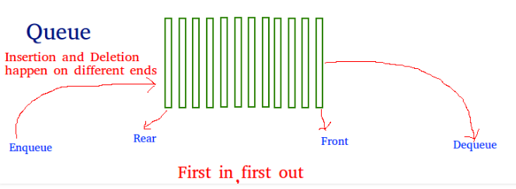
REPRESENTATION
[4]

Slide 28
APPLICATION OF QUEUES
Operating systems often maintain a queue of processes that are ready to execute or that are waiting for a particular event to occur.
Computer systems must often provide a “holding area” for messages between two processes, two programs, or even two systems. This holding area is usually called a “buffer” and is often implemented as a queue

Slide 29
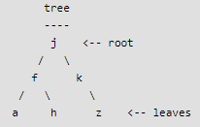
Trees
Unlike Arrays, Linked Lists, Stack and queues, which are linear data structures, trees are hierarchical data structures.
Tree Vocabulary: The topmost node is called root of the tree. The elements that are directly under an element are called its children. The element directly above something is called its parent. For example, a is a child of f and f is the parent of a. Finally, elements with no children are called leaves.

Slide 30
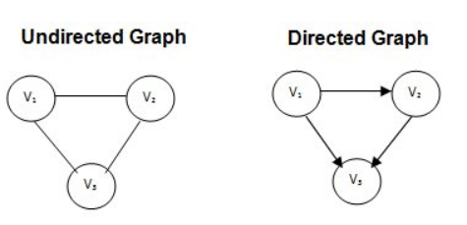
Definition of Graph
A graph G consists of two sets
a finite, nonempty set of vertices V(G)
a finite, possible empty set of edges E(G)
G(V,E) represents a graph
An undirected graph is one in which the pair of vertices in a edge is unordered, (v0, v1) = (v1,v0)
A directed graph is one in which each edge is a directed pair of vertices, <v0, v1> != <v1,v0>

Slide 31
Examples for Graph
0
0
0
1
2
1
2
1
3
3
4
5
6
G1
2
G2
complete graph
incomplete graph
G3
V(G1)={0,1,2,3} E(G1)={(0,1),(0,2),(0,3),(1,2),(1,3),(2,3)}
V(G2)={0,1,2,3,4,5,6} E(G2)={(0,1),(0,2),(1,3),(1,4),(2,5),(2,6)}
V(G3)={0,1,2} E(G3)={<0,1>,<1,0>,<1,2>}

Slide 32
References
Lipschutz, Seymour, “Data Structures”, Schaum's Outline Series, Tata McGraw Hill.
Goodrich, Michael T., Tamassia, Roberto, and Mount, David M., “Data Structures and Algorithms in C++”, Wiley Student Edition.
https://www.tutorialspoint.com/data_structures_algorithms/algorithms_basics.htm
https://www.cs.utexas.edu/users/djimenez/utsa/cs1723/lecture2.html

Slide 33
Books Recommended
Lipschutz, Seymour, “Data Structures”, Schaum's Outline Series, Tata McGraw Hill.
Gilberg/Forouzan,” Data Structure with C ,Cengage Learning.
Augenstein,Moshe J , Tanenbaum, Aaron M, “Data Structures using C and C++”, Prentice Hall of India

Slide 34
THANK YOU

